Slide 1
Unsupervised Learning of Multiple Motifs in
Biopolymers Using Expectation Maximization
T. L. Bailey and C. Elkan
Machine Learning, Vol. 21, No. 1-2, pp. 51-80, 1995.
Reporter : 劉威廷
Date : Nov.28 2003

Slide 2
MEME: multiple expectation/maximization for motif elicitation
You start with a set of sequences that have common motif but you don’t know the motif is ,nor where it is .You have a large number of samples to work with
You guess the length of the motif,and you guess the location of the motif in each sequence .

Slide 3
MEME
(3)Base on your initial guess,you assign a score (probability) to each possible location of the motif in each sequence
(4)Based on the probabilities,you refine your guess.Then repeat (3)

Slide 4
Input: A set T of n sequences S1, S2, · · · , Sn, and motif length w.
Output: A motif x1, x2, · · · , xn, each of length w, where each xi is a substring of Si.

Slide 5
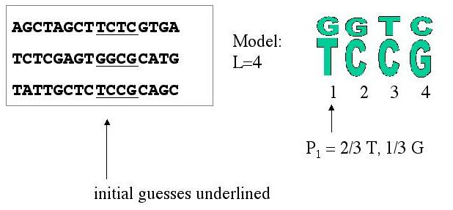
Initial guess of motif location
From the motif location you make profile model

Slide 6
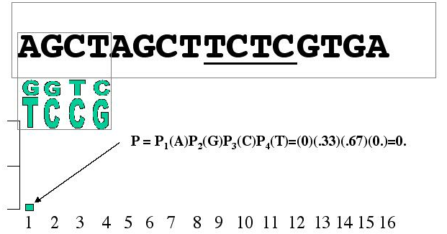
Calculate the probability score for each position
From the profile model and the sequence,
get probability scores.

Slide 7
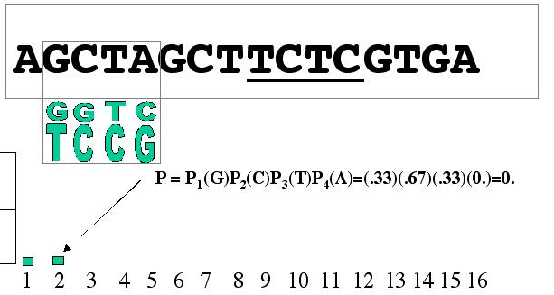
Calculate the probability score for each position
Slide the model along the sequence to get the next score

Slide 8
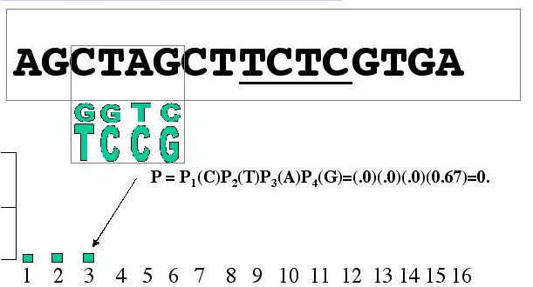
Calculate the probability score for each position
Slide the model along the sequence to get the next score

Slide 9
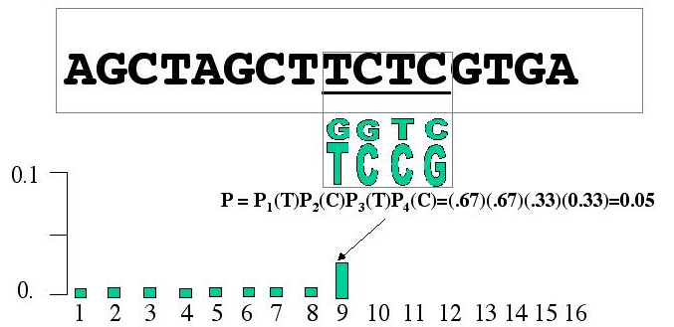
Calculate the probability score for each position
Slide the model along the sequence to get the next score

Slide 10
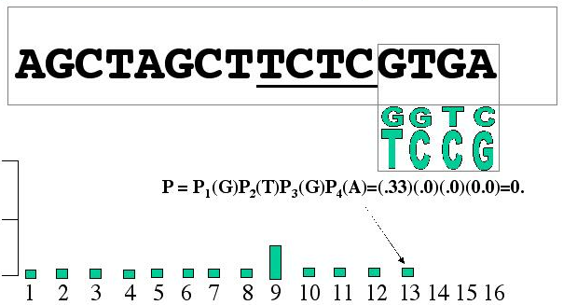
Calculate the probability score for each position
Slide the model along the sequence to get the next score

Slide 11
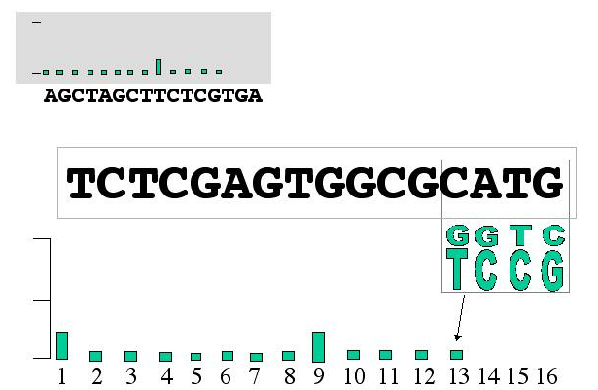
Calculate the probability score for each position
Do every sequence

Slide 12
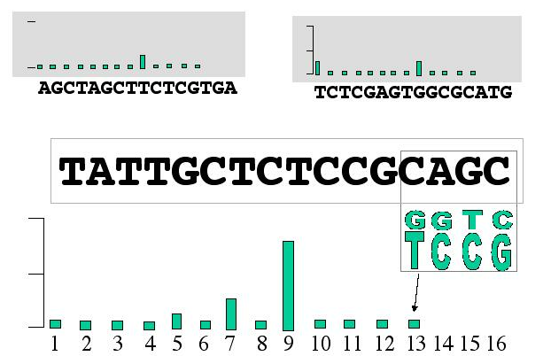
Do every sequence

Slide 13
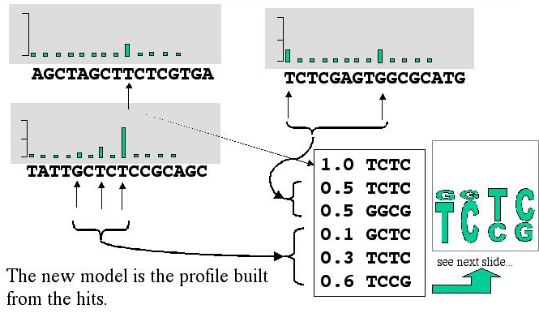
Re-Calculate the motif model
Probabilities are normalized to sum to one for each sequence,since we expect exactly one motif per sequence

Slide 14
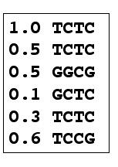
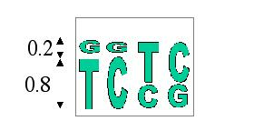
Recalculating the profile from the hits
P1(T)=the probability of T in the first position= the sum of the scores for sequences with T in the first position normalized
P1(T)=1.0+0.5+0.3+0.6/1.0+0.5+0.5+0.1+0.3+0.6
= 0.8

Slide 15
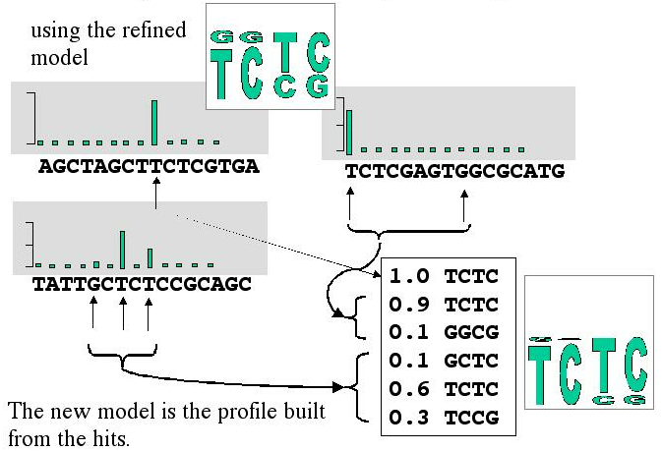
Do it again:Re-Calculate the probability scores

Slide 16
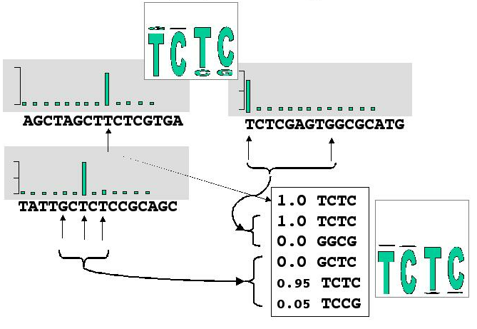
And again,until converged

Slide 17
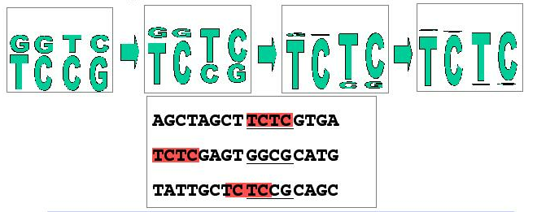
EM converges on the conserved pattern if the initial guess was not too far off
A summary of the exercise

Slide 18
If the true motif was not one of the initial guesses ,or some combination of the initial guesses,then EM would never find the true
motif

